Slide 1
CaFi
Team 5

Slide 2
Table of Contents
Team
Overview
Proposed Technologies
Proposed High Level Requirements
Management Plan
Configuration Management Plan
Quality Assurance Plan

Slide 3
Team
Matthew Kluska | Overall team leader
Aidan Chang | Design and Implementation leader
Derric Syme | Configuration leader
Brendan Truong | QA leader
Patounezambo OUEDRAOGO | Requirement leader
Zengrui Luo | Security leader

Slide 4
Overview
Cafi = Cat Finder
Our project is about the creation of an image recognition application leveraging ML CV frameworks.
Specifically, users will be able to submit images to our web application and be told whether any cats are present.

Slide 5
Proposed Technologies Utilized
PyTorch, other Python libraries
Flask to create front end
Git/Github for version control
Possible AWS services
EC2, Cloudwatch, Elastic Beanstalk for deployment

Slide 6
Proposed High Level Requirements
Front-end website
Essential Features:
The website consists of two tabs:
Main Tab: Tab where an end user can upload and submit an image from their local machine.
History Tab: Tab where we will display historic submission events
Desirable Features:
The website can access the webcam to capture live photos.
User account with SSO, MFA, and other security features.
Filters for searching and historical management in the history tab.
Optional Features:
Build the app on phone applications
Have the WebUI be mobile browser friendly and retain a good experience cross platform.
The ability to upload and predict on a directory of images or multiple images.

Slide 7
Proposed High Level Requirements
ML Algorithm
Essential Features:
We will be utilizing a pre-trained cat detection model implemented by pytorch.
Goal is to achieve 95% accuracy.
Returns confidence rate alone with predictions.
Desirable Features:
Enable a flexible framework where we can easily substitute the ML model and UI text to accommodate for other identifiers (interchangeably identify other animals or objects)
This could be configurable through a file configuration or by highlighting key directions to fork and replace essential modules.

Slide 8
Proposed High Level Requirements
Nonfunctional Requirements
Usability requirement User-friendly User Interface
Reliability requirement The application needs to be reliable at >95%
Compatibility requirement The application should function with most browsers and most image types(e.g .jpg, png, PNG, JPEG, PPM, GIF, TIFF, and BMP etc.)
Responsiveness requirement Responsive UI (That is, the web UI should be responsive and intuitive to user interaction)
Security requirement The application should be secure especially using back-end security measures such that no unauthorized data type can be used as input. Similarly, unauthorized users should not have access to the service.
Delivery Requirement The software should be ready for use by the deadline
Implementation Requirement The software should be be written in Python: Flask, Pytorch

Slide 9
Management Plan
Our top priorities are:
Identify and test existing ML Models in local environment
Establish APIs and set up back-end server
Establish front-end architecture and successfully connects to the ML API

Slide 10
Management Plan
Our top risks are:
Configure our environment across the board to run ML libraries.
Decide the best existing ML model that we want to implement
Decide the best suitable back-end server.
Decide the best suitable connectivity (API) we want to use.

Slide 11
Management Plan
Our time line for each features (functions)
Front-end Development:
Main tab (35 hours)
History tab (35 hours)
ML Algorithm Optimization:
Pick the most suitable pre-trained model (10 hours)
Implemented to our application (30 hours)

Slide 12
Configuration Management Plan
Tools
Version Control:
Github
IDE tools:
Python IDE such as Pycharm, Spyder, VS Code
CI/CD automation:
Github Actions
DevOps:
Pivotal Tracker

Slide 13
Configuration Management Plan
Deployment Plan
Front-end: We will be using Flask to develop our web framework
Back-end: we will be using AWS Elastic Beanstalk to deploy our application onto an AWS EC2 instance
Codes will be stored in AWS S3
CloudWatch monitors the load of the instance, and configure an auto scaling group

Slide 14
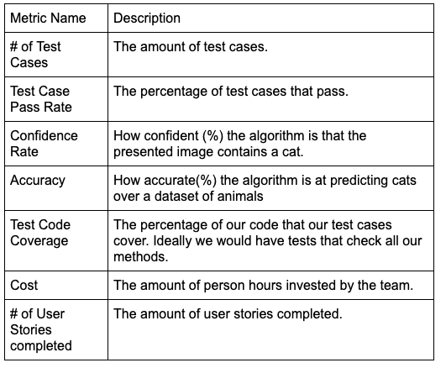
Quality Assurance Plan
Metrics

Slide 15
Quality Assurance Plan
Standards
Our code will follow the PEP 8 coding convention. (https://peps.python.org/pep-0008/)
Code Review Process
At Least one peer must review a pull request before it can be merged (enforced by the repository setting). All team members will be involved in the code review process.

Slide 16
Quality Assurance Plan
Testing
A collection of unit tests can be integrated for feature testing.
The QA leader will provide special focus in integration testing of front end UI and the backend along with performance testing of the end to end application from a user experience perspective.
The test suite will be automated through Github Actions
Defect Management
The team will use GitHub issues for defect management. Issues will be raised whenever a team member discovers a defect or potential enhancement in their work.
The QA leader will be in charge of reviewing any issues, measuring urgency, and solutioning.

